Slide 1
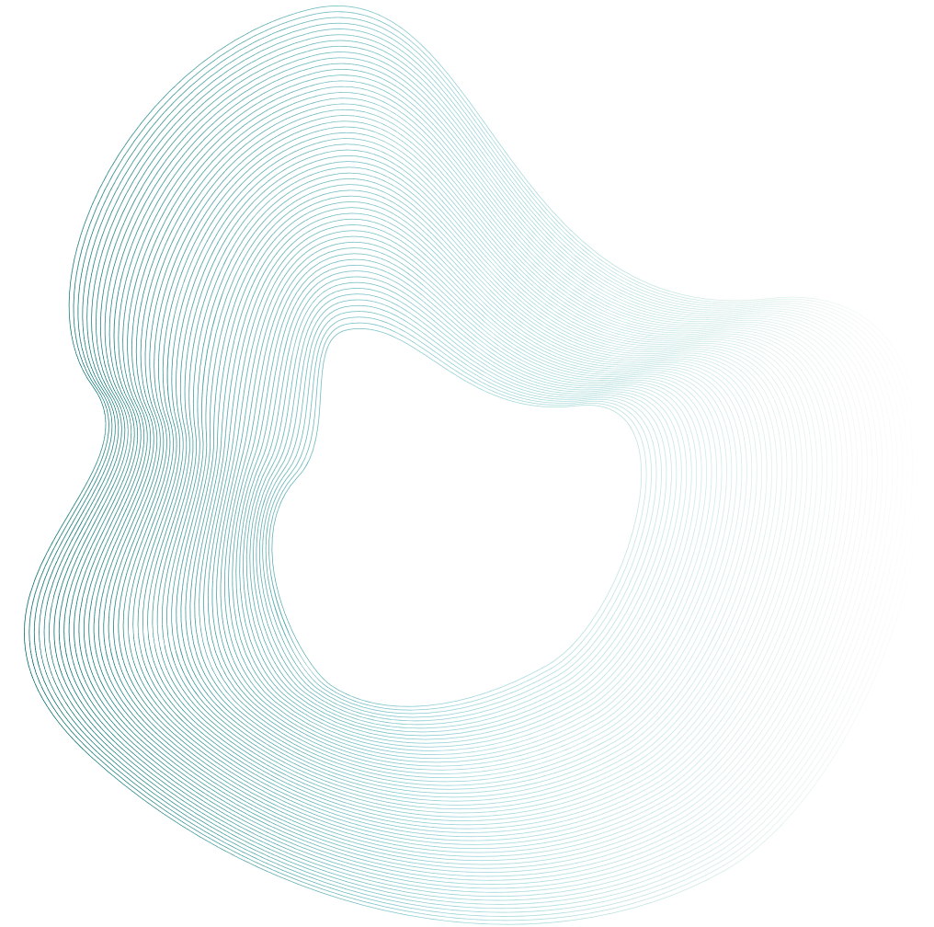
LifeWell XAI: Life Satisfaction Detection System
MD Fahim Hossain Khan
Ahmad Abdullah Sifat
Poner Hossain Piyal
Smrity Akter Ful

Slide 2


Project Overview
  Objective: LifeWell XAI is a machine learning–based system designed to predict an individual’s life satisfaction level using a small set of user responses, reducing survey complexity while maintaining prediction accuracy.
  Problem Statement: Traditional life satisfaction assessment methods rely on lengthy surveys and manual analysis, which are time-consuming and inefficient for large-scale data.
  Proposed Solution: The system applies supervised machine learning algorithms to identify patterns in user-provided attributes and automatically classify life satisfaction status.
  Methodology: Multiple models—including Logistic Regression, KNN, Naive Bayes, SVM and Gradient Boosting—are trained and evaluated to select the best-performing classifier.
  Outcome: The final model is deployed via a web-based interface that enables real-time life satisfaction prediction, supporting data-driven decision-making and user experience optimization.

Slide 3
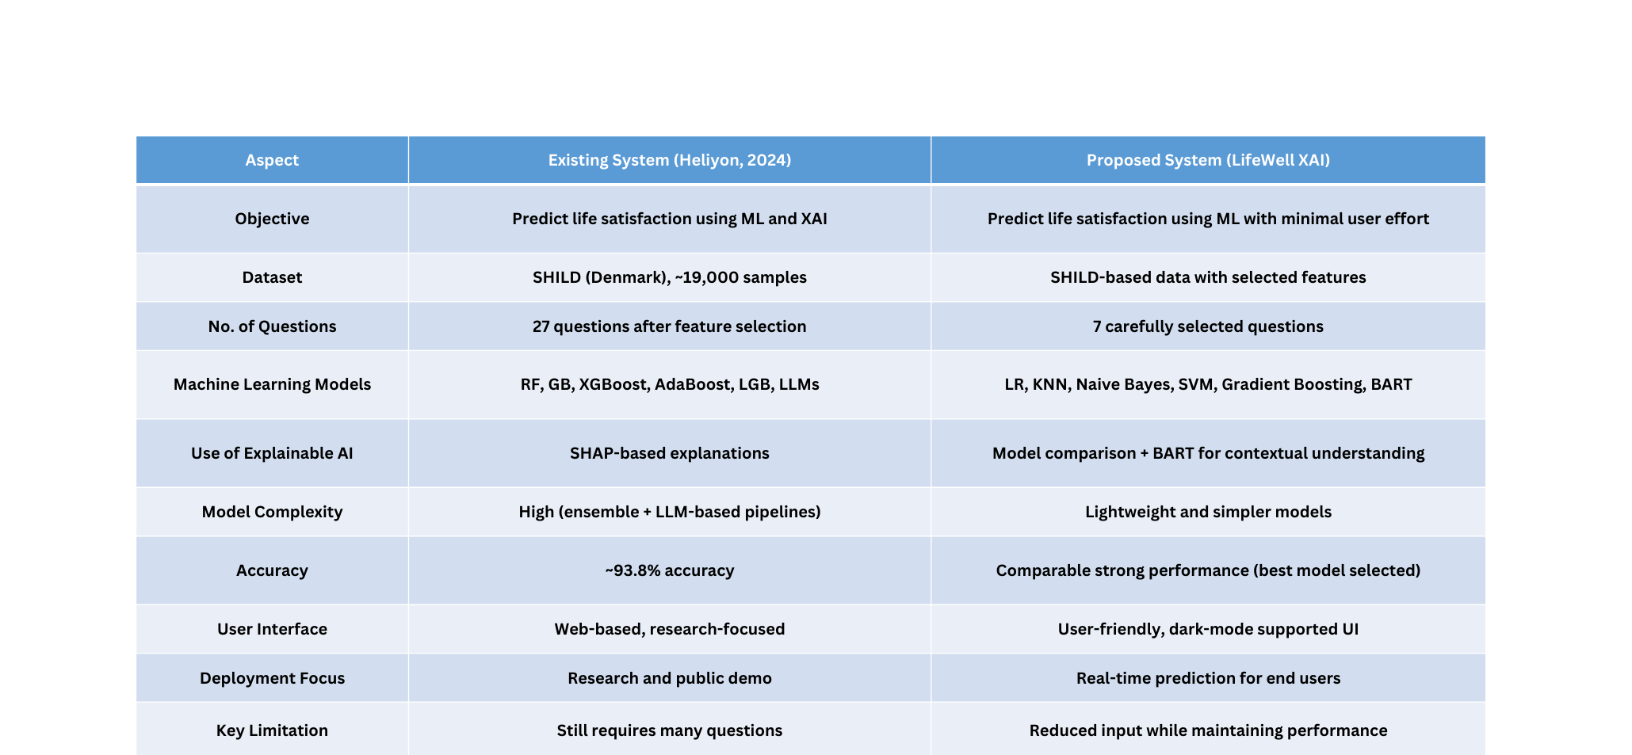
Comparison with Existing System
Content
Predicting life satisfaction using machine learning and explainable AI
Khan, Alif Elham et al.
Heliyon, Volume 10, Issue 10, e31158

Slide 4

Novelties of LifeWell XAI
  Minimal Question-Based Prediction: Predicts life satisfaction using only 7 carefully selected questions, significantly reducing user effort compared to traditional long surveys while maintaining reliable performance.
  Multiple Machine Learning Model Integration: Implements and evaluates diverse supervised models including Logistic Regression, KNN, Naïve Bayes, SVM, Gradient Boosting, and BART for robust model comparison and selection.
  Incorporation of BART Model: Integrates the BART (Bidirectional and Auto-Regressive Transformers) model to capture contextual and semantic patterns in user responses, enabling better modeling of complex relationships.
  Inclusion of Probabilistic & Instance-Based Models: Unlike many existing studies, includes Naïve Bayes (probabilistic) and KNN (instance-based) classifiers to enhance analytical diversity.
  User-Friendly Web-Based Interface: Provides an intuitive web platform that allows users to easily input responses and receive instant life satisfaction predictions.
  Dark Mode Supported Design: Includes dark mode support to improve accessibility, user comfort, and real-world usability, especially in low-light environments.

Slide 5
System Architecture and Workflow
Data Collection & Preparation
Interactive Testing
Real-time validation
User Interface Development
Data Preprocessing
• Binary Target
• Drop rows with missing target
• Drop cols >20% missing
Custom Helper Functions
Testing the Web Application
Feature Separation
• Separate numeric & categorical
• Iterative imputation for numeric
• Handle categorical features
Traditional ML Models
• Logistic Regression
• Random Forest
• XGBoost
• LightGBM
• Support Vector Machine (SVM)
• K-Nearest Neighbors (KNN)
• Naive Bayes
Train and evaluate all models
Testing Predictions
Validate model performance
on test dataset
DEPLOYMENT
Product Release
Feature Selection – RFECV
Recursive Feature Elimination
with Cross-Validation
using Random Forest
Exploratory Data Analysis (EDA)
Model Comparison
LLM (BART) vs Traditional Models
Performance Metrics Analysis
Save Best Model
Reload for deployment
Large Language Model
BART Model
Fine-tuning and training
on preprocessed data
Model Evaluation
• Confusion Matrix (Best Model)
• Bar Plot: Accuracy & Macro F1
• Comparative Analysis
(LLM vs Traditional Models)
Train/Test Split
Dual Resampling
• SMOTE (Oversample minority)
• Undersample majority class
Best Model Selection
Based on Accuracy &
Macro F1-Score

Slide 6
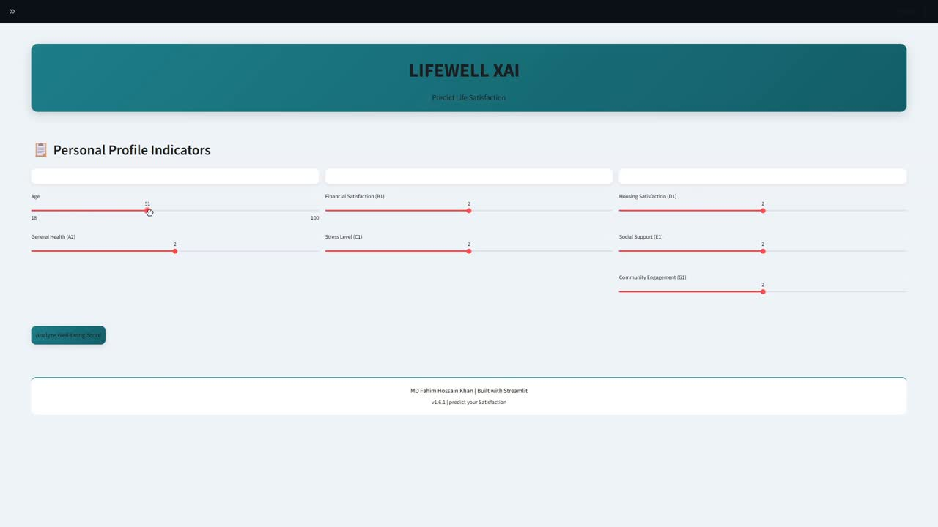
System Demonstration

Slide 7
Individual Contributions – Team LifeWell XAI
1. MD Fahim Hossain Khan (ID: 2232359042) •Led the app development using Sreamlit. •Implemented machine learning models into a functional application. •Conducted initial training & testing of KNN and other models (Gradient Boosting models). •Model Training with LLM (Bart model). •Managed dataset review, preprocessing and model evaluation metrics. •Drafted and organized the project report. | 2. Ahmad Abdullah Sifat (ID: 2233017042) •Assisted in app development, troubleshooting bugs and refining workflows. •Implemented XGBoost and Naive Bayes models for prediction. •Prepared evaluation metrics for all models. •Designed and organized the presentation slides for the final delivery. •Ensured data consistency and preprocessing for all ML models.
3. Poner Hossain Piyal (ID: 2232512642) •Conducted research on relevant ML papers and applied feature selection. •Implemented SVM (Linear & RBF). •Compared performance metrics of all models. •Created and submitted weekly progress updates. Assisted in documenting initial model results. | 4. Smrity Akter Ful (ID: 2231875042) •Designed UI/UX for LifeWell XAI app using Figma. •Created low-fidelity wireframes and basic screen layouts. •Defined application requirements and user flow. •Conducted research for front-end & back-end integration. •Prepared weekly project progress summaries for the team.

Slide 8
Results – LifeWell XAI
• The LifeWell XAI system demonstrates strong performance in predicting life satisfaction while minimizing user input. Among the implemented models, Gradient Boosting and XGBoost showed the highest overall accuracy, with Gradient Boosting achieving an accuracy of 93.34% and a balanced precision-recall profile, resulting in an F1-score of 0.93. XGBoost performed consistently well, offering an accuracy of 91.98% and the highest F1-score of 0.9565, highlighting its reliability in handling the structured survey dataset.
• Random Forest also performed competitively, providing robust predictions with an accuracy of 91.79%. In contrast, simpler models like Logistic Regression, SVM, and KNN exhibited moderate to lower performance, with KNN being the least effective in terms of recall and overall classification accuracy. The BART model, while achieving high accuracy, showed lower recall and F1-score, suggesting some misclassification of user satisfaction levels.
• Overall, the results confirm that ensemble-based models provide the most reliable predictions, while LifeWell XAI’s integration into a user-friendly, interactive app makes it a practical and accessible tool for end-users. The system not only maintains strong predictive performance comparable to existing research but also reduces user effort by relying on only 7 carefully selected survey questions.
• After evaluating all models, Gradient Boosting was selected for the LifeWell XAI application due to its highest accuracy and well-balanced performance, making it the most reliable choice for real-world deployment with minimal user input.

Slide 9
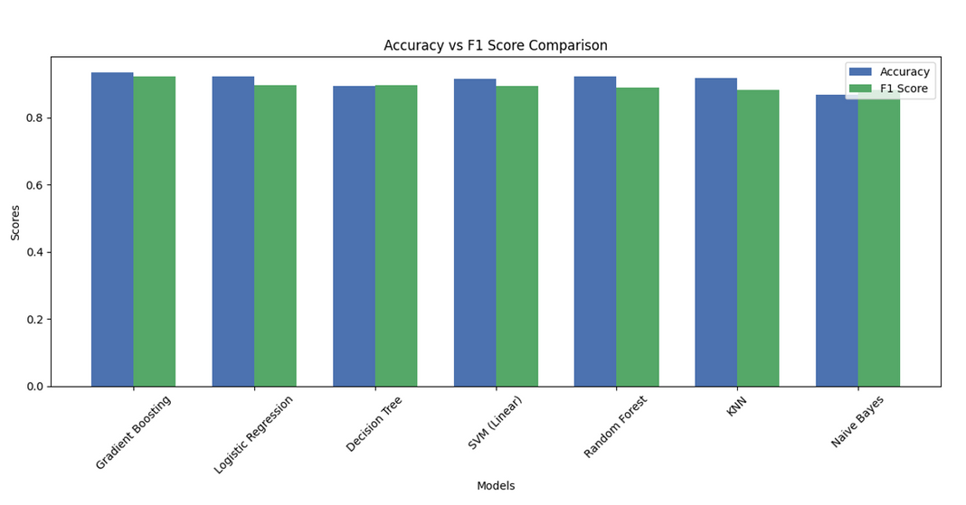
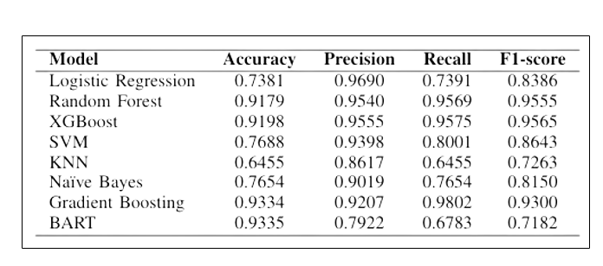
Evaluation Metrics of LifeWell XAI Models
Performance Comparison of Machine Learning Models
Comparison of Accuracy and F1-Score Across the Evaluated Models

Slide 10
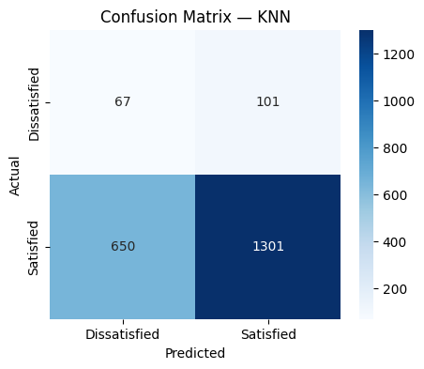
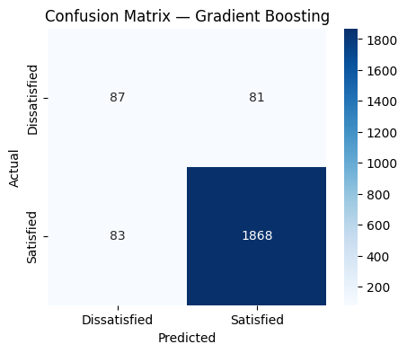
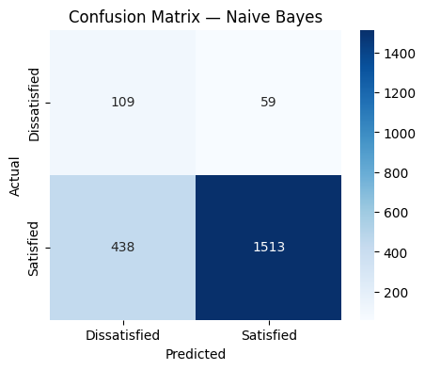

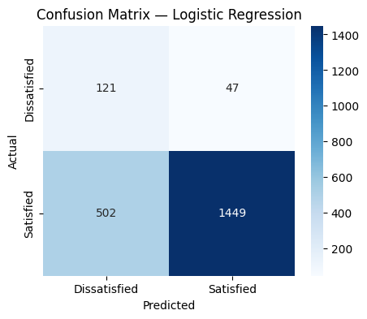

Confusion Matrix Analysis

Slide 11
Conclusion & Proposed Future Work – LifeWell XAI
Conclusion:
•LifeWell XAI predicts user life satisfaction using only seven key questions, significantly reducing user effort.
•Ensemble models like Gradient Boosting and XGBoost achieved highest predictive performance, while traditional classifiers (LR, SVM) showed moderate performance.
•BART demonstrated high accuracy but lower recall and F1-score, suggesting the need for further fine-tuning of transformer-based models.
•The system’s user-friendly web interface enhances practical usability, making it suitable for real-world applications.
Proposed Future Work:
•Expand to a larger and more diverse dataset to improve model generalizability across demographics and cultures.
•Fine-tune deep learning models (e.g., BART) to improve recall and F1-score.
•Explore hybrid models combining transformer representations with traditional ML classifiers.
•Integrate natural language input for richer user feedback and more accurate predictions.
•Extend the application to mobile platforms, with multilingual support and personalized feedback.
•Incorporate real-time, longitudinal tracking to monitor changes in user satisfaction over time.

Slide 12
Thank You!

Slide 13







Meet Our Team
SMRITY FUL
FAHIM KHAN
AHMAD SIFAT
PONER PIYAL
2231875042
2232359042
2233017042
2232512642

